Slide 1
Chapter 12
Equilibrium
12-1 Equilibrium
12-2 The Requirements of Equilibrium
12-3 The Center of Gravity
12-4 Some Example of Static Equilibrium

Slide 2

12-1 Equilibrium
Static equilibrium
An object is in equilibrium if the total forces acting upon it is equal to zero.
An object is in static equilibrium if it is not moving:
Smooth rolling
Stationary
Surface
Surface
Surface
The disk is
in equilibrium
The block is
in equilibrium
The block is
in static equilibrium

Slide 3






12-2 The Requirements of Equilibrium
Balance of forces and torques
The two requirements for an object to be in equilibrium:
1- The vector sum of all the external forces that act on the object must be zero. (balance of forces)
2- The vector sum of all the external torques that act on the object, measured about any point, must be zero. (balance of torques)
We will consider only situations in which the forces that act on the object lie in the xy plane.
Balance of forces
Balance of torques

Slide 4



12-3 The Center of Gravity
Definition
The gravitational force F_{g} on an object effectively acts at a single point, called the center of gravity (cog) of the object.
If g is the same for all elements of an object, then the object's center of gravity (cog) is coincident with the object's center of mass (com).
g varies a little along Earth's surface and decrease in magnitude slightly with altitude.
For small objects, like a house, com = cog, but for large objects, like a huge mountain, com ≠ cog.
We can treat a solid object as a point object of mass M located at its center of gravity
center of gravity
Mass M
Mass M

Slide 5








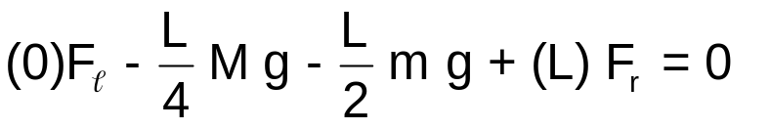

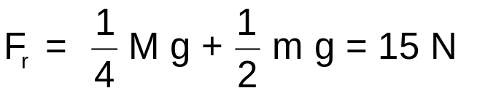


12-4 Some Example of Static Equilibrium
Example 1
Beam mass m = 1.8 kg
Block mass M = 2.7 kg
What do the scales read?
Normal force on the beam from the scale
Block
M
Beam
Solution
mass = m
The scale reading is the magnitude of the normal force on the scale from the beam F_{SB}.
By Newton's third law F_{SB} = F_{BS}
Scale
Scale
Scale
Normal force on the scale from the beam
Balance of forces along y axis
Balance of torques about the left end
To have no contribution from F_{ℓ}
Block
M
Beam
mass = m
F_{ℓ} and F_{r} are the magnitude of the normal forces on the beam from the scales.
The reading of the left scale = F_{ℓ} = 29 N
The reading of the right scale = F_{r} = 15 N

Slide 6
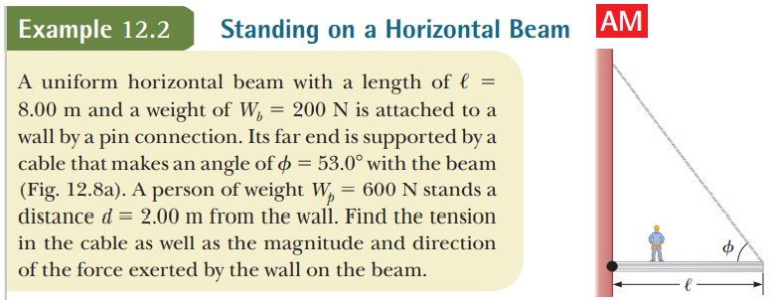
Ans:
T = 313N
F_{N} = 188.4N
F_{v} = 550N

Slide 7
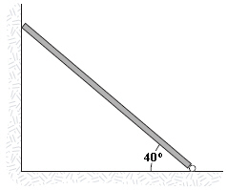
A uniform beam having a mass of 60 kg and a length of 2.8 m is held in place at its lower end by a pin. Its upper end leans against a vertical frictionless wall as shown in the figure. What is the magnitude of the force the pin exerts on the beam? (Ans: 684N)

Slide 8
